Slide 1
Step_finding

Slide 2
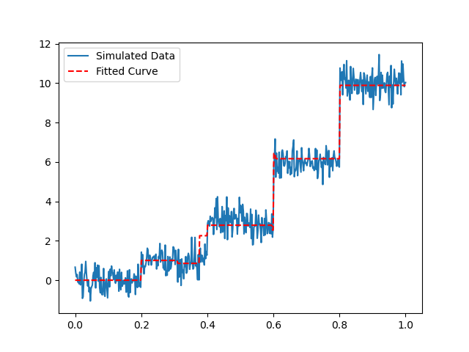
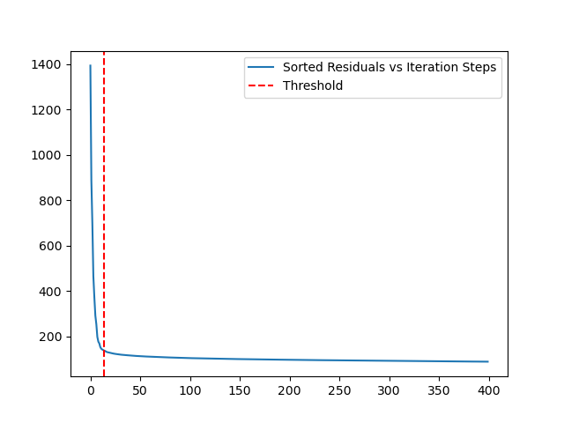
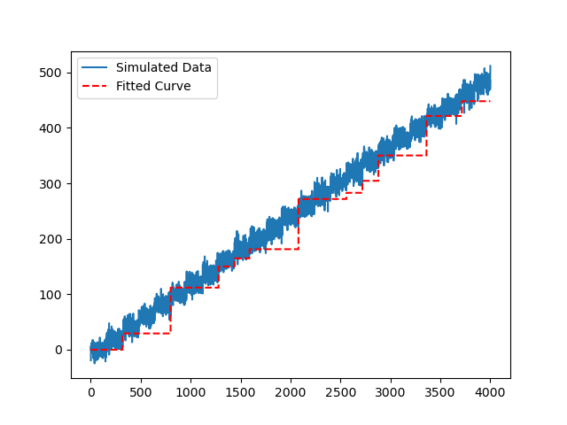
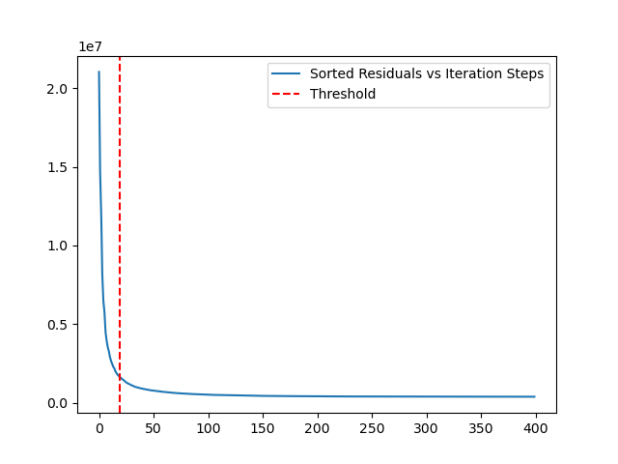
Method#1:
find the residuals of each two adjacent data points on a calculation of the Chi-squared. After all the residuals been detected, they should be sorted from lager value to smaller value, a threshold should be 95% residuals reduced compared with the initial one (largest residuals).
Running time = ~10s
Data_point = 500
Max_iteration= 400
Threshold = 90%
Step_size = [1,4]
Sd_noise = 0.5
Running time = ~70s
Data_point = 4000
Max_iteration= 400
Threshold = 95%
Sd_noise = 0.5

Slide 3
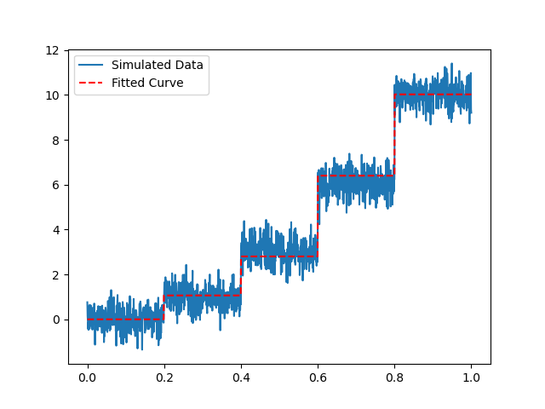
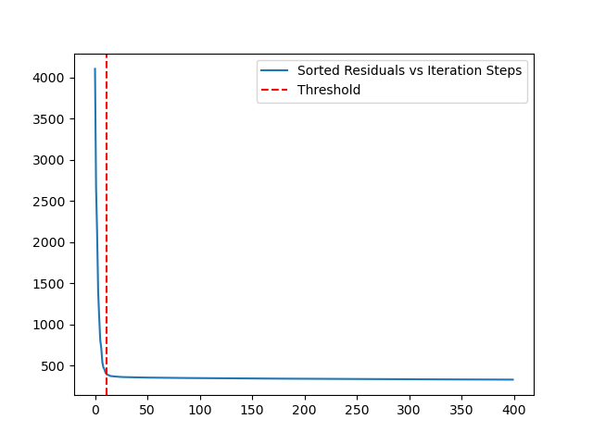
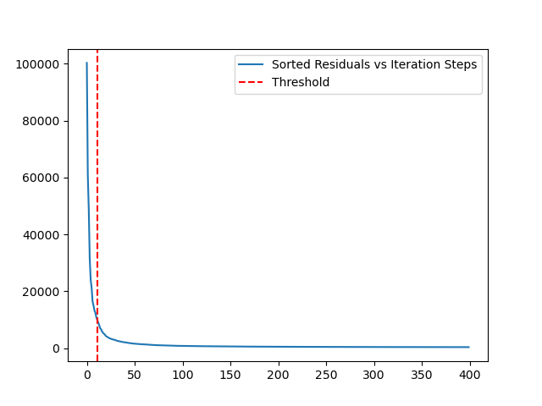
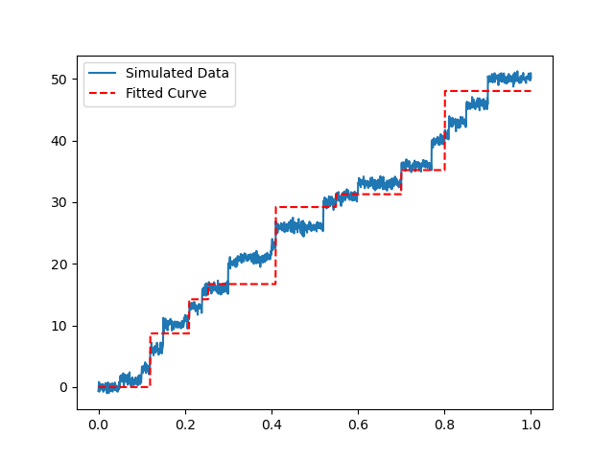
Running time = ~30s
Data_point = 1500
Max_iteration= 400
Threshold = 95%
Step_size = [1,4]
Sd_noise = 0.5
Running time = ~35s
Data_point = 1500
Max_iteration= 400
Threshold = 95%
Step_size = [1,4]
Sd_noise = 0.5
Iteration time significantly affects the running time and quality
This method can’t handle more steps

Slide 4
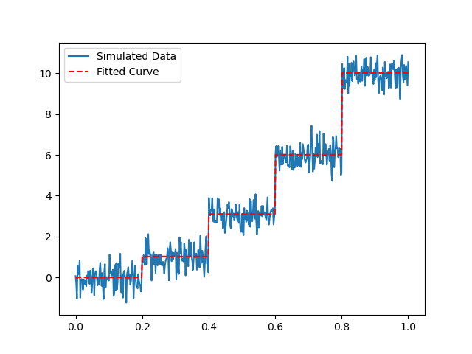
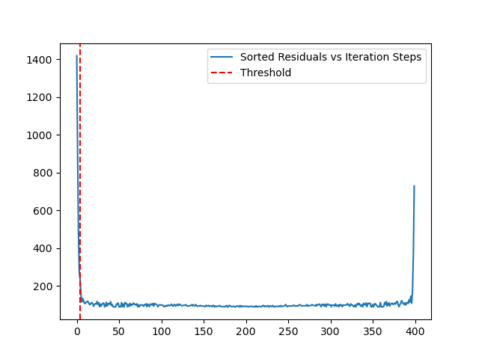
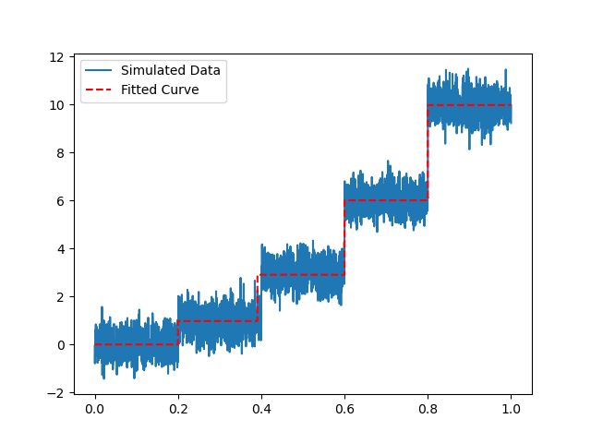
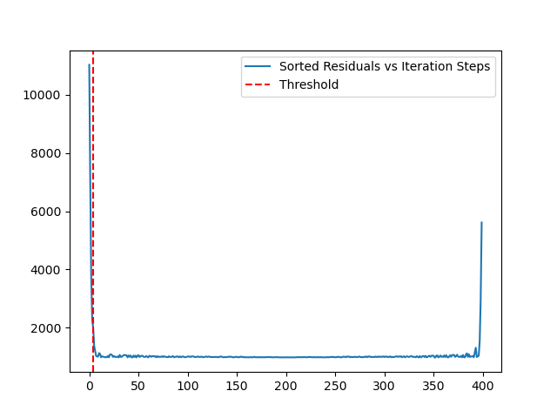
Method#2:
Use the same method to find all the steps, instead of sorting residuals, the step_size should be sorted. Now a minimum step size is set as a threshold (such as the RMS noise); the sorted step size should be larger than the threshold, to detect all the step location; afterwards, step sizes based on the mean values between adjacent step locations once the optimal step locations are found
Running time = ~10s
Data_point = 500
Max_iteration= 400
threshold = 0.5
Step_size = [1,4]
Sd_noise = 0.5
Running time = ~70s
Data_point = 4000
Max_iteration= 400
threshold = 0.5
Step_size = [1,4]
Sd_noise = 0.5

Slide 5
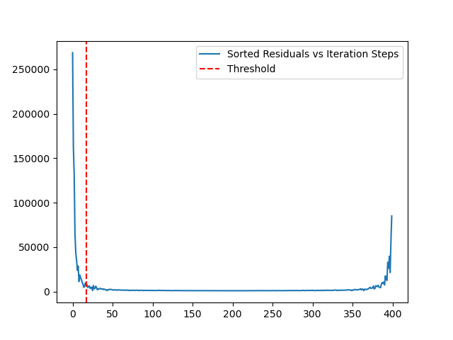
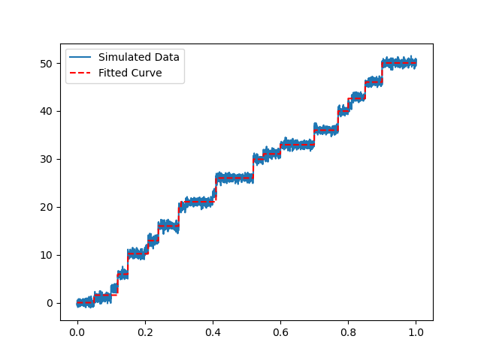
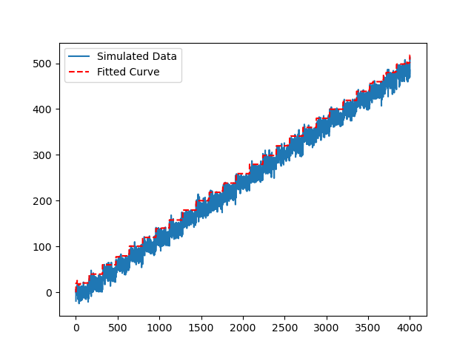
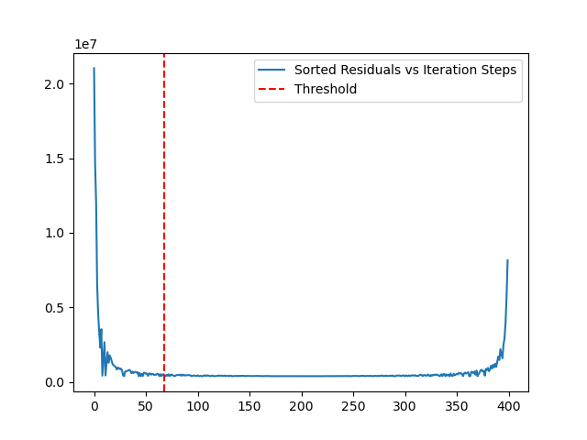
Running time = ~35s
Data_point = 4000
Max_iteration= 400
threshold = 0.5
Step_size = [1,4]
Sd_noise = 0.5
Running time = ~70s
Data_point = 4000
Max_iteration= 400
threshold = 0.5
Sd_noise = 0.5

Slide 6
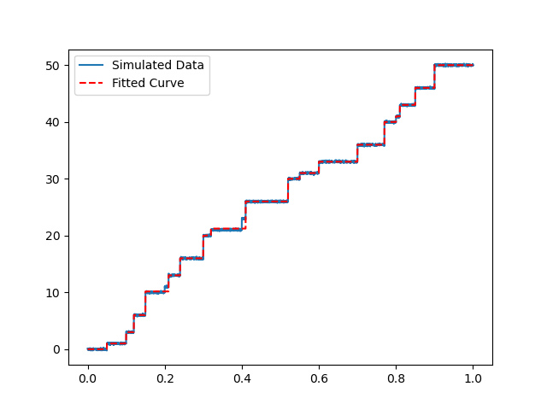
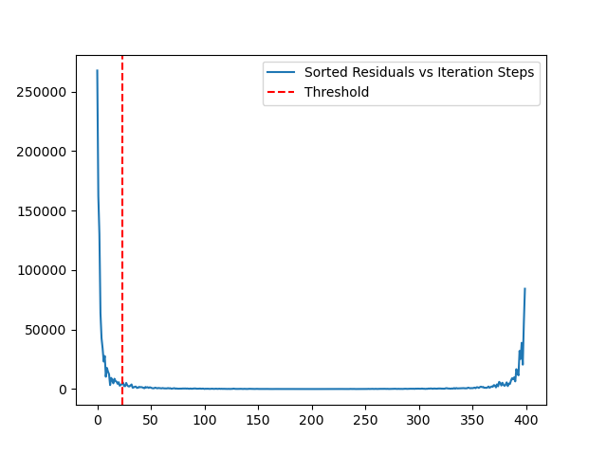
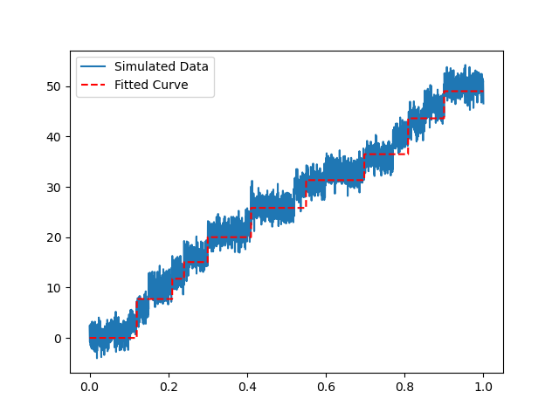
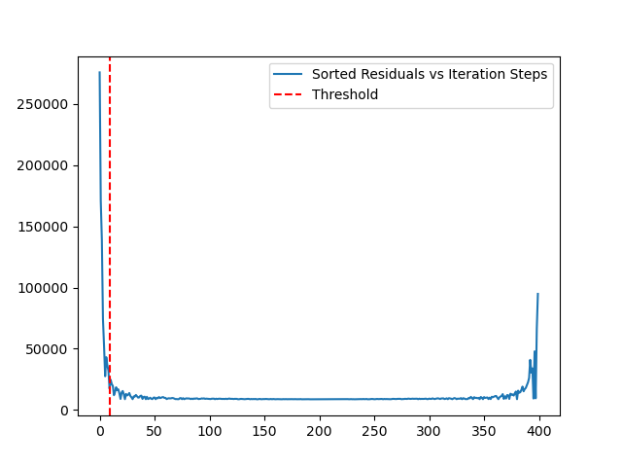
Running time = ~35s
Data_point = 4000
Max_iteration= 400
threshold = 0.5
Step_size = [1,4]
Sd_noise = 0.5
Running time = ~35s
Data_point = 4000
Max_iteration= 400
threshold = 0.1
Step_size = [1,4]
Sd_noise = 0.1
Running time = ~35s
Data_point = 4000
Max_iteration= 400
threshold = 1.5
Step_size = [1,4]
Sd_noise = 1.5

Slide 7
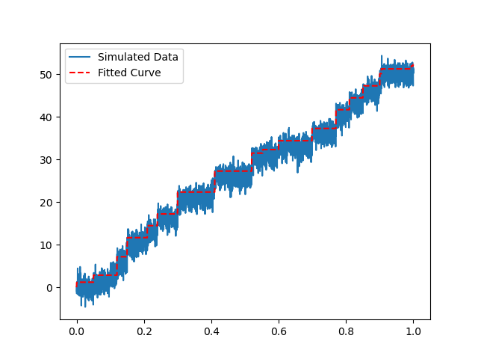
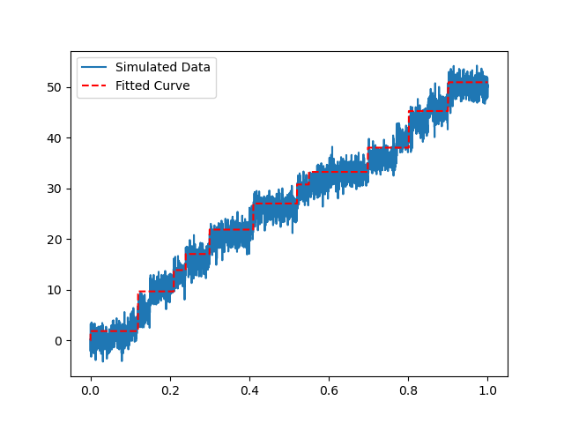
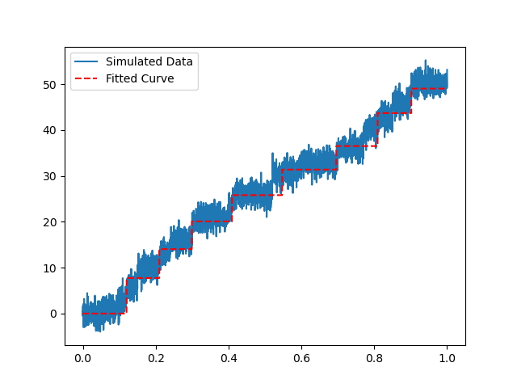
Running time = ~35s
Data_point = 4000
Max_iteration= 400
threshold = 0.5
Step_size = [1,4]
Sd_noise = 1.5
Running time = ~35s
Data_point = 4000
Max_iteration= 400
threshold = 1
Step_size = [1,4]
Sd_noise = 1.5
Running time = ~35s
Data_point = 4000
Max_iteration= 400
threshold = 2
Step_size = [1,4]
Sd_noise = 1.5

Slide 8
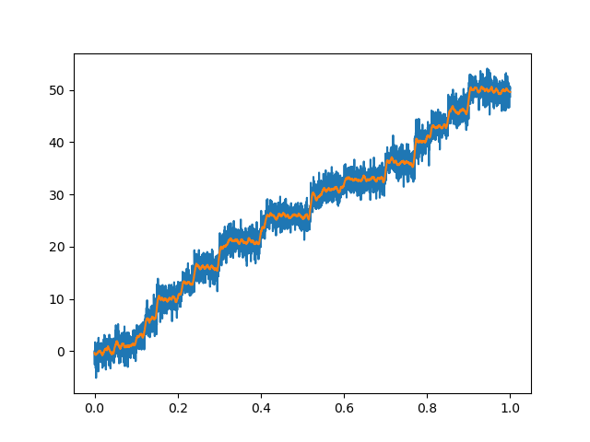
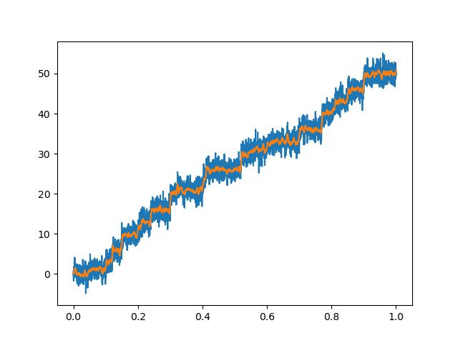
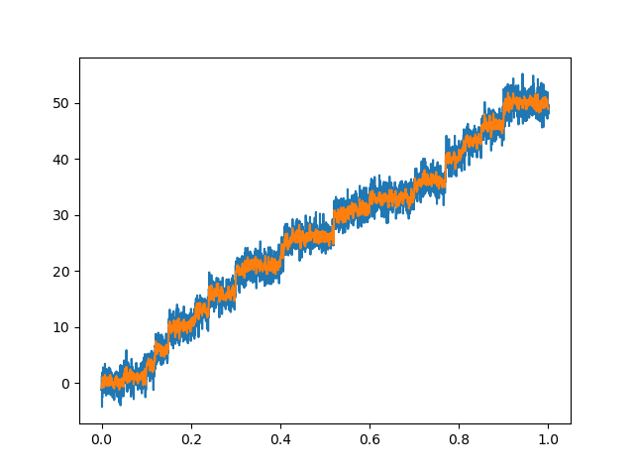
Two strategies
#1: automatically determine the noise level and pass that value to the algorithm
You can estimate the noise standard deviation (RMS noise) can be estimated using the median absolute deviation (MAD). The MAD is a robust measure of the spread of a distribution, and it's less sensitive to outliers than the standard deviation. To convert the MAD to an estimate of the standard deviation, we can use the following formula:
estimated_std = MAD(data) * scaling_factor (default is 1.4826)
scaling_factor ,should be in the range of [0.8,1.5], is used to estimate the noise level, higher value give higher noise, lesss steps been detected.
#2: filter the noise, and then process it
One common approach is using a Savitzky-Golay filter, which smooths the data using a local polynomial regression.
Win = 51
Win = 31
Win = 11
Noise_ori = 1.567
Noise_fil = 0.0547
Noise_ori = 1.567
Noise_fil = 0.088
Noise_ori = 1.567
Noise_fil = 0.2652

Slide 9
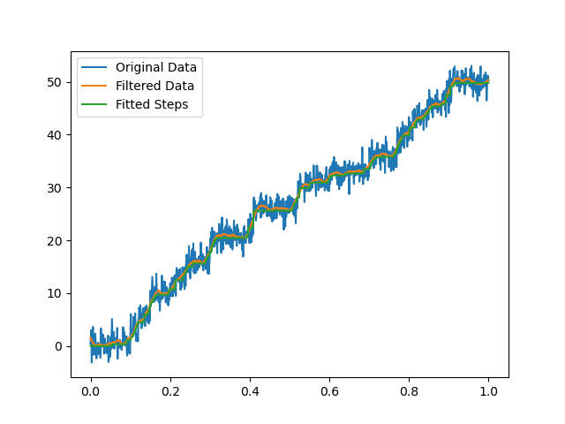
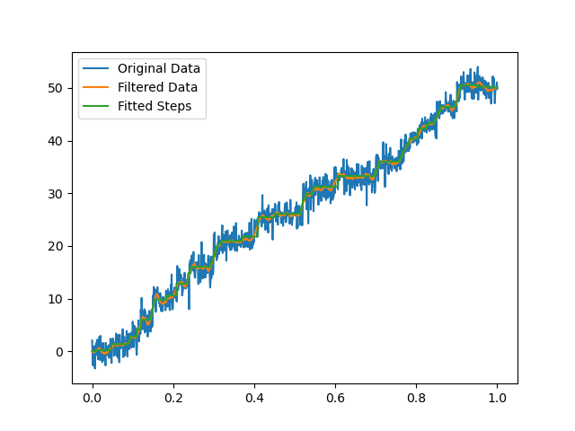
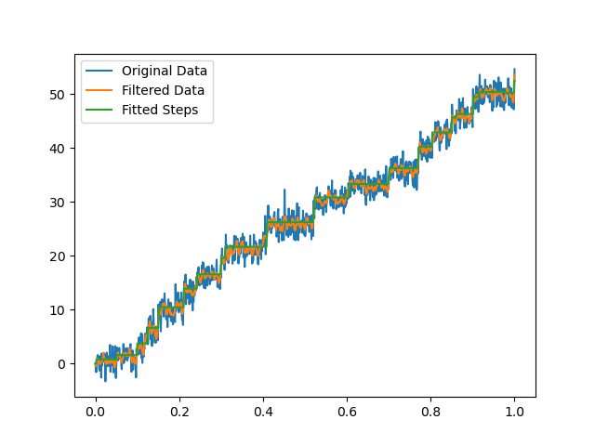
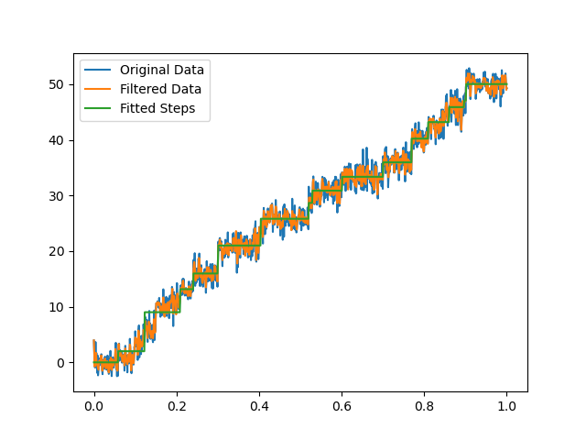
Win = 51
Win = 31
Win = 11
Win = 5
Step_found = 118
Step_real = 20
Step_found = 76
Step_real = 20
Step_found = 31
Step_real = 20
Step_found = 16
Step_real = 20
Slightly filter the raw data is good enough for getting better step-fit results
This method is not good at ’gradual-changing’ traces

